Slide 1


Slide 2
Chapter 9
Qualitative Methods

Slide 3
Introduction
Different approach to qualitative inquiry
Educating readers of the intent
Tell reader about the design
Comments on role of researcher

Slide 4
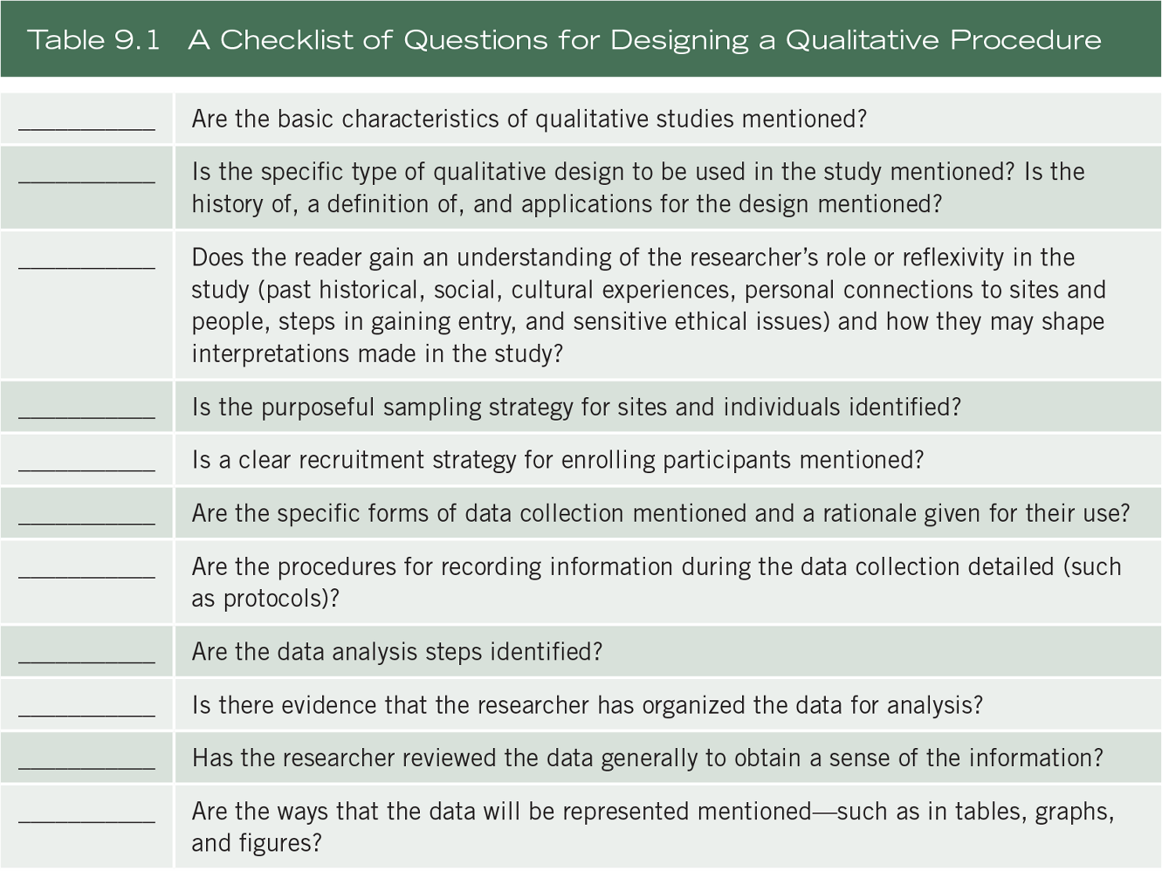
Qualitative Methods

Slide 5
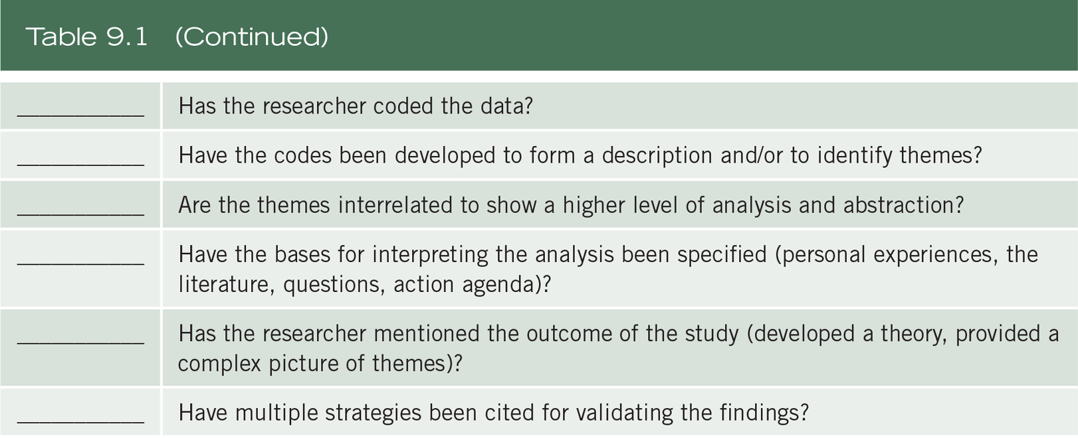
Qualitative Methods

Slide 6
The Characteristics of Qualitative Research
Review the needs of potential audiences for the proposal
May need to discuss characteristics of qualitative research
  Natural setting
  Researcher as key instrument
  Multiple sources of data
  Inductive and deductive data analysis
  Participants' meanings
  Emergent design
  Reflexivity
  Holistic account

Slide 7
Qualitative Designs
Specific approaches in conducting qualitative research
Include procedures for data collection, analysis, and writing
Designs include
  Narrative
  Phenomenology
  Ethnography
  Case study
  Grounded theory

Slide 8
The Researcher’s Role and Reflexivity
Researcher has sustained intensive experience with participants
Ethical issues can arise
Researchers should comment on
  Past experiences with participants, setting or research problem
  How these experiences shape the interpretations

Slide 9
The Researcher’s Role and Reflexivity
Memos reflect on developing codes and themes
Connection between researchers, participants, site that may influence interpretations
Indicate steps to get IRB permissions

Slide 10
The Researcher’s Role and Reflexivity
Discuss steps to gain entry into the setting
Gatekeepers – individuals at the site who provide access
A brief proposal may help

Slide 11
The Researcher’s Role and Reflexivity
Proposals to gatekeepers
  Why was the site chosen for study?
  What activities will occur at the site?
  Will the study be disruptive?
  How will the results be reported?
  What will the gatekeeper gain from the study?

Slide 12
Data Collection Procedures
Purposefully select individuals and sites to best understand the problem
Discuss strategies to recruit
Comment on the number of sites and participants
Saturation – fresh data no longer sparks new insights or reveals new properties

Slide 13
Data Collection Procedures
Types of qualitative data collection
  Qualitative observations
  Qualitative interviews
  Qualitative documents
  Qualitative audio-visual materials
  (see Table 9.2)

Slide 14
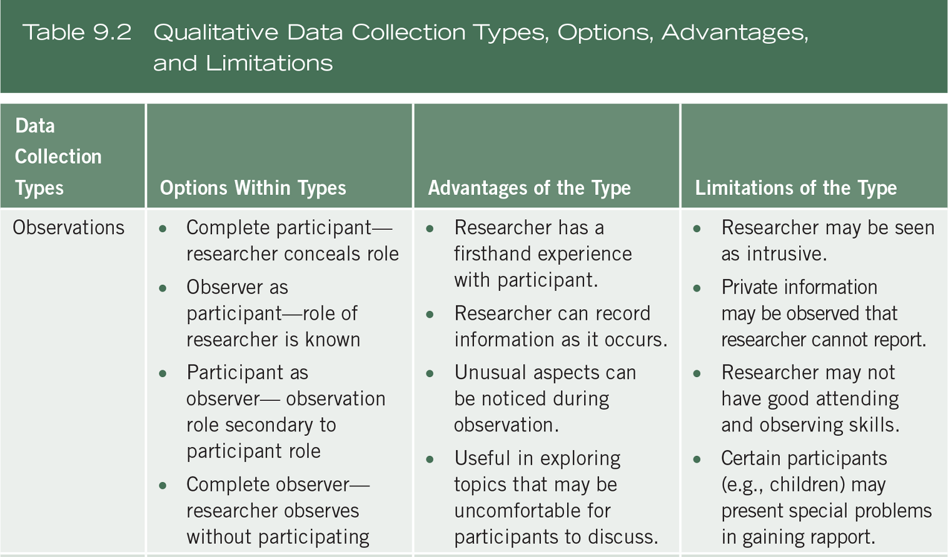
Data Collection Procedures

Slide 15
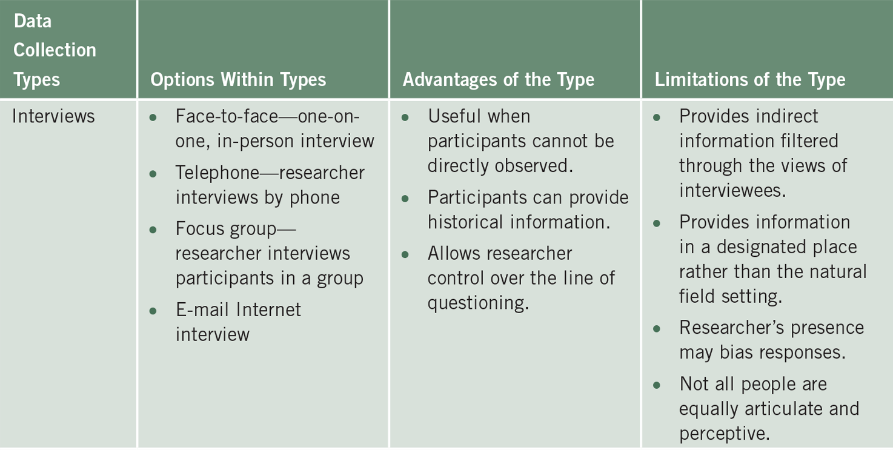
Data Collection Procedures

Slide 16
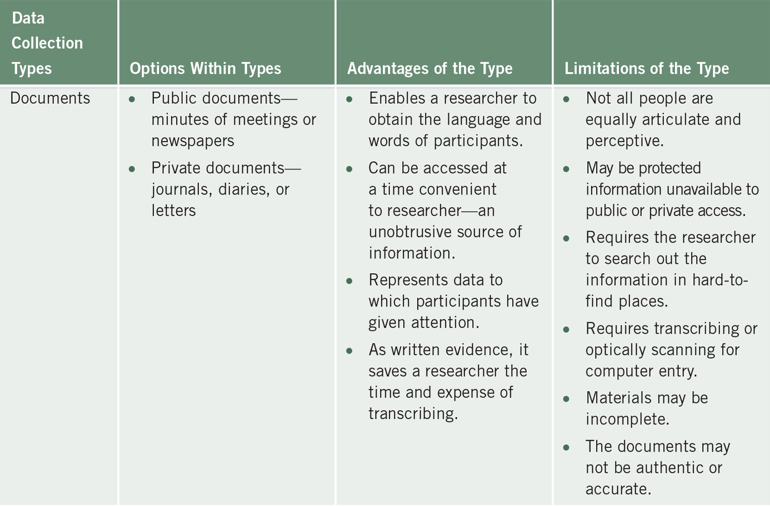
Data Collection Procedures

Slide 17
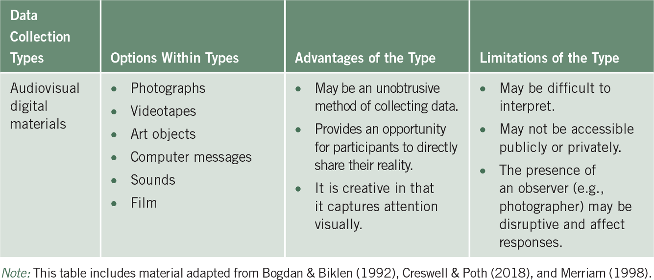
Data Collection Procedures

Slide 18
Data Collection Procedures
Be specific about types
Include data collection types beyond typical observations and interviews
These unusual forms create reader interest and can capture useful information .
(see Table 9.3)

Slide 19
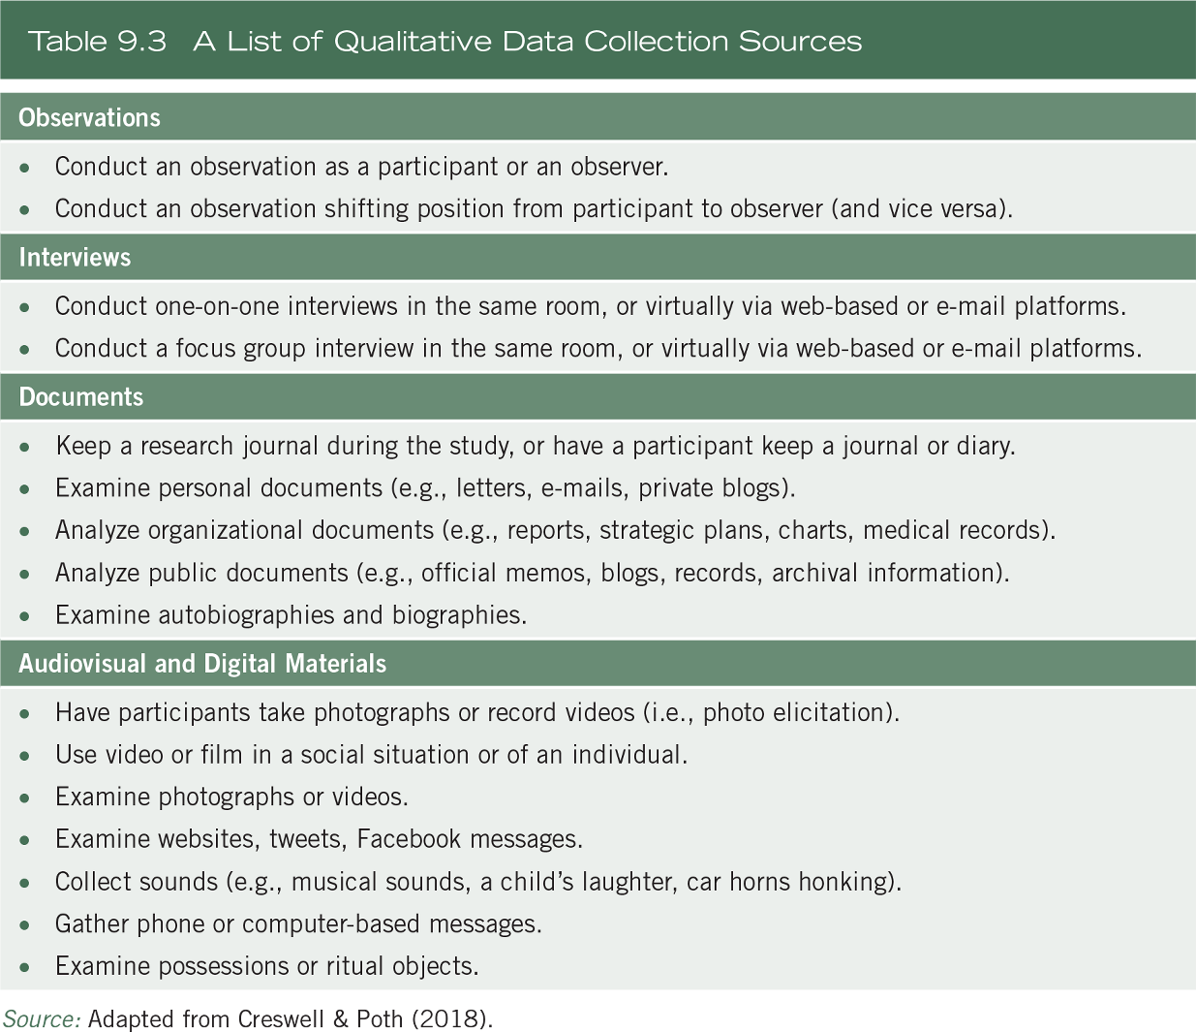
Data Collection Procedures

Slide 20
Data Recording Procedures
Observational protocol – record information while observing
  Record descriptive notes
  Reflexive notes
  Demographic information
  Setting

Slide 21
Data Recording Procedures
Interview protocol for asking questions and recording answers
  Information about interview, introduction, questions and probes, closing instructions
  Perhaps 5 to 10 questions
  Prepare in advance
  Memorize questions

Slide 22
Data Analysis Procedures
Segment and take apart the data and put back together
Data analysis will proceed hand-in-hand with data collection and the write-up of findings
Winnowing the data because it is dense
Aggregate into five to seven themes
Use a computer software program

Slide 23
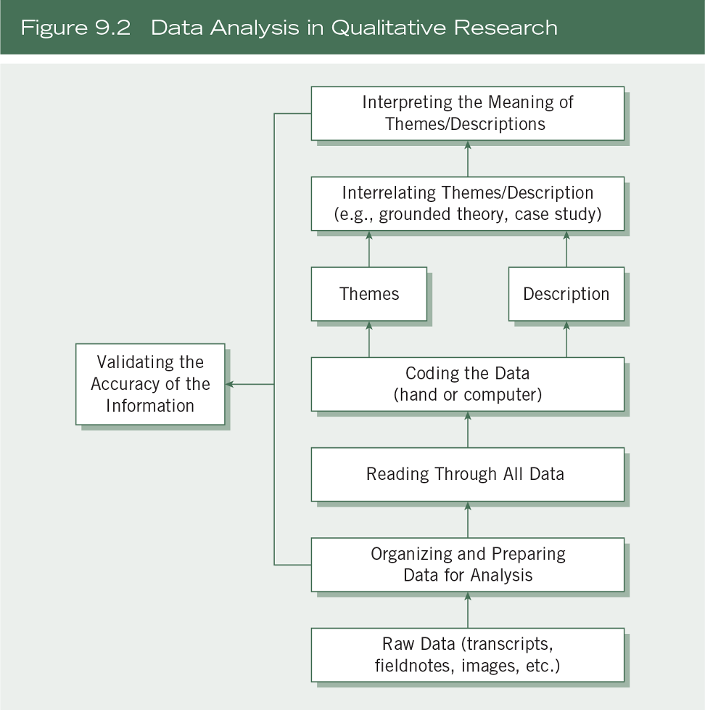
Data Analysis Procedures

Slide 24
Data Analysis Procedures
Step 1 – Organize and prepare the data for analysis
e.g., Transcribing interviews
Step 2 – Read or look at all the data
Gain a general sense of the data

Slide 25
Data Analysis Procedures
Step 3 – Start coding all of the data
Coding – organize data by bracketing chunks
Labeling with a term (code), often based on language of participants

Slide 26
Data Analysis Procedures
Step 4 – Generate a description and themes
Step 5 – Represent the description and themes
  Narrative discussion, figures, tables, quotes

Slide 27
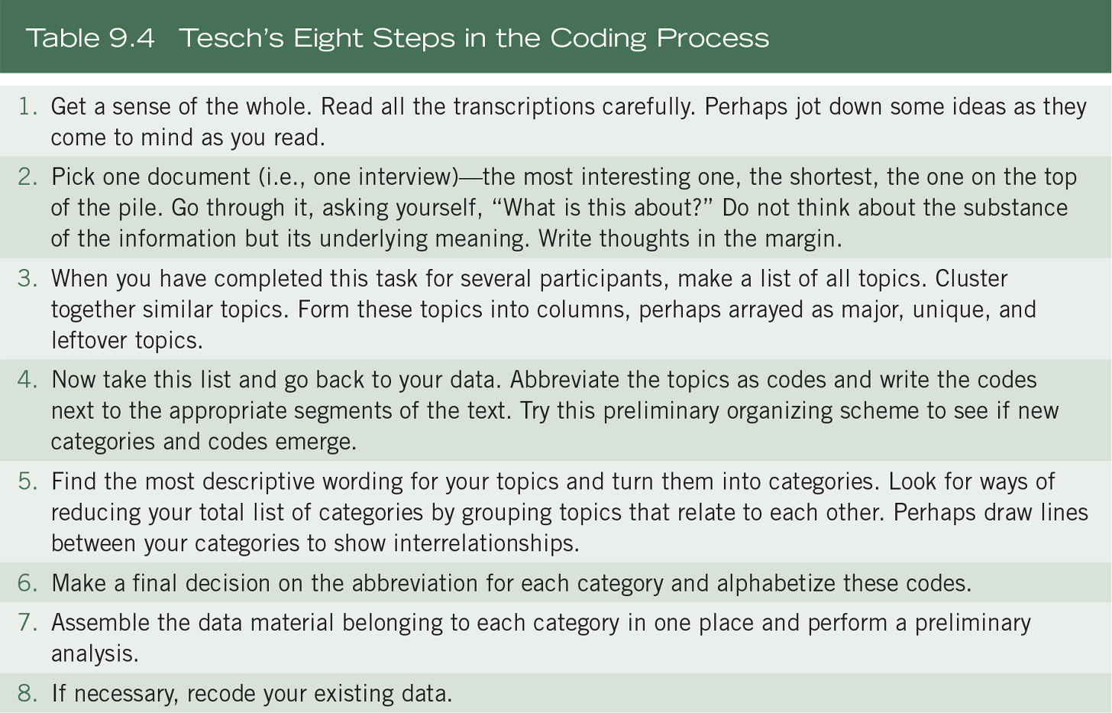
Data Analysis Procedures

Slide 28
Data Analysis Procedures
Categories of codes
  Expected codes
  Surprising codes
  Codes of unusual or conceptual interest
  Predetermined codes
Visual images may be coded

Slide 29
Data Analysis Procedures
Further data analysis by approach
  More general procedures
  Analysis embedded within specific qualitative designs

Slide 30
Interpretation
Interpretation in qualitative research
  Summarize overall findings, compare to literature
  Use a theoretical lens
  Convey personal, research-based, and action meanings
  Suggest limitations and future research

Slide 31
Validity and Reliability
Qualitative validity
  Determine whether findings are accurate from standpoint of researcher, participant, or readers

Slide 32
Validity and Reliability
Use multiple validity procedures
  Triangulate
  Member checking
  Rich, thick description
  Clarify bias
  Negative information
  External auditor
  Peer debriefing
  Prolonged time in the field

Slide 33
Validity and Reliability
Qualitative reliability
  Researcher uses an approach that is consistent across different analysts and projects
  Check transcripts for mistakes
  Ensure no drift in definition of codes
  Communication among coders
  Cross-check codes by different researchers

Slide 34
Validity and Reliability
Qualitative generalization
  Used in limited way in qualitative research
  Focus on the particularity, not generalizability
  Case study results may generalize to broader theory

Slide 35
Writing the Qualitative Report
Plan for the narrative
  Developing description and themes
  Considering how sections will be presented
Convey the following:
  Use quotes
  Dialogue that reflects culture
  Varied narrative form
  Use the first person
  Use metaphors and analogies
  Narrative reflects strategies

Slide 36
Summary
Components of writing a qualitative methods section
  Characteristics of qualitative research
  Data collection
  Data analysis
  Expected outcomes
  Strategies to validate

